Slide 1
Healthcare Claim Submission
Presented by- Angsuman Patra
Mentor-Sai Krishna Nallamati

Slide 2
User Interface(Angular)
Architecture
MicroService (Dot Net Core API)
Database(SQL server)
Azure implementation

Slide 3

User Interface with Angular

Slide 4
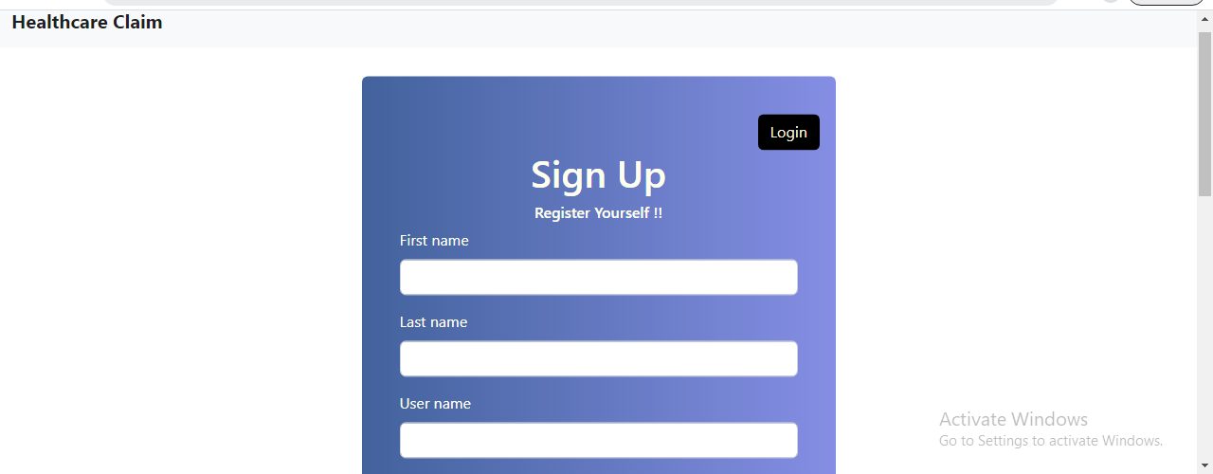
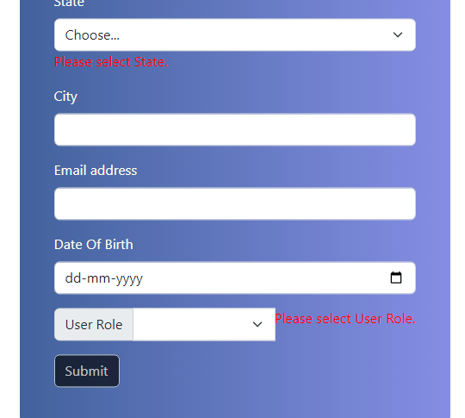
User Registration

Slide 5
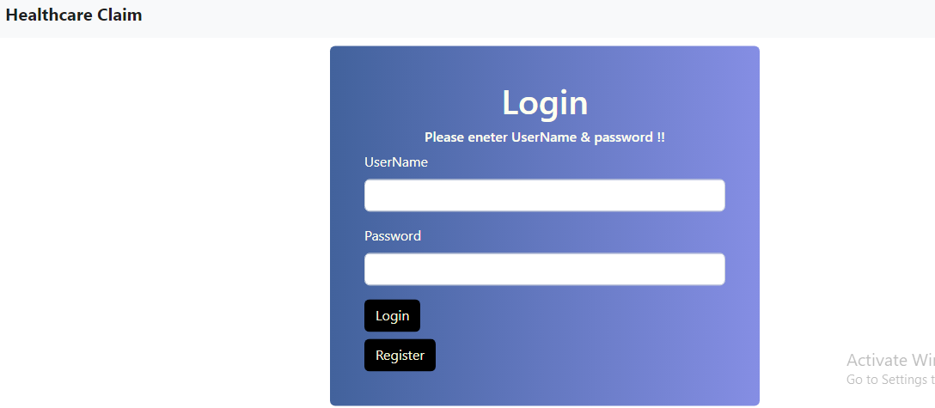
User Login

Slide 6
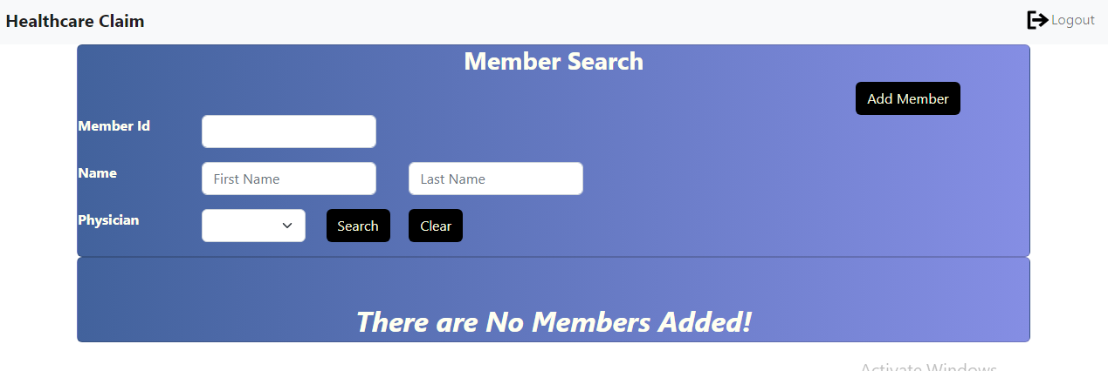
Admin Screen

Slide 7
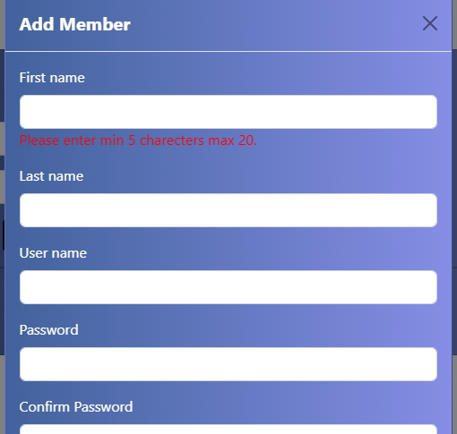
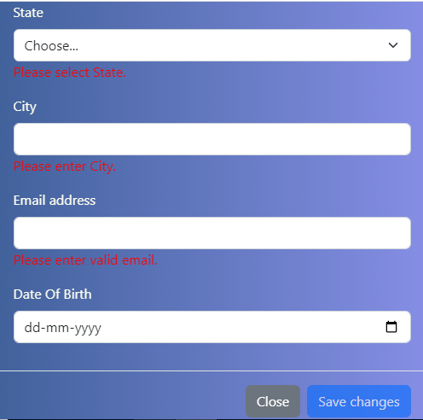
Add Member

Slide 8
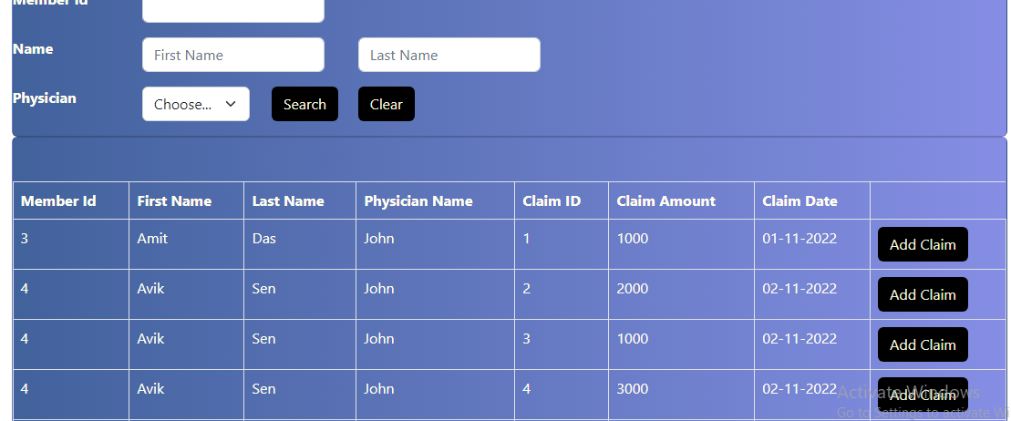
List Of Members

Slide 9
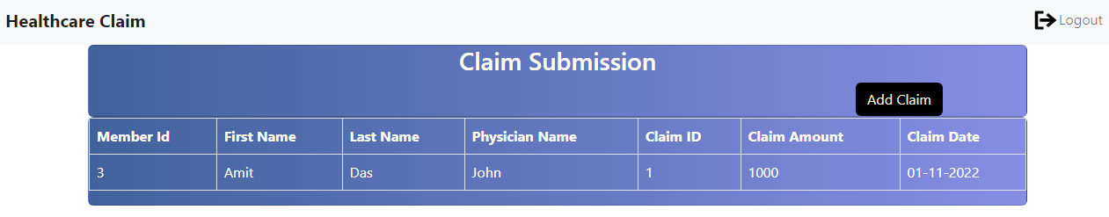
Member screen

Slide 10
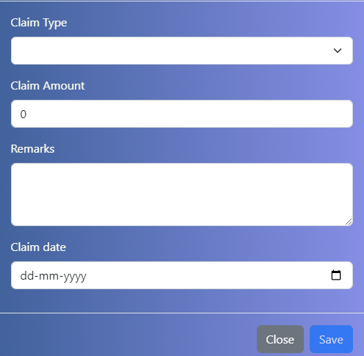
Claim Submission screen

Slide 11
Angular Implementation
Form validation
Lazy Loading
Dependency Injection
Unit testing with Jasmine and KARMA

Slide 12
Architecture
Micro services
User interface
Database
Member
service
Angular
Gateway
Ocelot
SQL
Claim
service

Slide 13

Microservice and Gateway with dot net Core

Slide 14
Web API Structure
Discovery service Consul
Consul
Member
Service
Register Service
Http Client
Retrieve Service Registered
Gateway
Claim
Service
Send - receive Request
Ocelot

Slide 15
Testing Web API
Swagger
Postman

Slide 16


